Slide 1



4-Bit Binary
Arithmetic Calculator
Design and Simulation in Logisim
KL University
Academic Year 2026–2027
Presented by Batch 1
2620030005 Divya Teja
2620030016 Amogh Andra
2620030018 Keerthi Sagar
2620030134 Siri Samanvitha
Guide: Kartheek V
Notes:
Project: 4-bit arithmetic calculator. Source: supplied presentation and verified Logisim circuit. Addition returns (A+B) modulo 16 with carry for A+B>15. Subtraction returns (A-B) modulo 16 with borrow for A<B. All 512 combinations were tested using the Logisim 2.7.1 simulation engine. Tables on slide 11 include the exhaustive 1-bit full-adder table and selected 4-bit cases.

Slide 2

Introduction
Project background
Digital systems represent numbers using binary digits. Arithmetic circuits combine
these bits to perform calculations that form part of a processor’s Arithmetic Logic Unit.
Domain overview
This project belongs to digital logic and computer architecture. It demonstrates
combinational arithmetic using 4-bit operands, XOR logic, and a shared adder.
Importance
The circuit makes two’s complement, carry propagation, and fixed-width results visible.
Interactive simulation connects arithmetic equations with the signals in a working design.
Notes:
Project: 4-bit arithmetic calculator. Source: supplied presentation and verified Logisim circuit. Addition returns (A+B) modulo 16 with carry for A+B>15. Subtraction returns (A-B) modulo 16 with borrow for A<B. All 512 combinations were tested using the Logisim 2.7.1 simulation engine. Tables on slide 11 include the exhaustive 1-bit full-adder table and selected 4-bit cases.

Slide 3
Problem Statement
The problem
Binary arithmetic is difficult to understand from equations alone. Learners need to see
how input bits, operation selection, and carries together determine the final answer.
Limitations of basic approaches
Manual calculations do not display signal flow. Separate addition and subtraction
blocks also make the shared principle behind the two operations less obvious.
Need and project scope
Build a small, interactive circuit that performs A + B and A − B using one adder.
Inputs are unsigned values 0–15. The design reports carry/borrow but not signed overflow.
Notes:
Project: 4-bit arithmetic calculator. Source: supplied presentation and verified Logisim circuit. Addition returns (A+B) modulo 16 with carry for A+B>15. Subtraction returns (A-B) modulo 16 with borrow for A<B. All 512 combinations were tested using the Logisim 2.7.1 simulation engine. Tables on slide 11 include the exhaustive 1-bit full-adder table and selected 4-bit cases.

Slide 4
Objectives
01 Build the arithmetic circuit
Connect a 4-bit adder, XOR logic, and a mode input to process two binary operands.
Use a common arithmetic path so both operations share the same adder.
02 Explain how subtraction works
Invert the bits of B and add 1 to form its two’s complement. Explain how the SUB
signal controls both the XOR gates and the initial carry-in of the adder.
03 Verify the outputs
Check ordinary calculations, zero values, equal operands, carry, and borrow cases.
Compare RESULT and the status flag against the expected answer for each input.
Notes:
Project: 4-bit arithmetic calculator. Source: supplied presentation and verified Logisim circuit. Addition returns (A+B) modulo 16 with carry for A+B>15. Subtraction returns (A-B) modulo 16 with borrow for A<B. All 512 combinations were tested using the Logisim 2.7.1 simulation engine. Tables on slide 11 include the exhaustive 1-bit full-adder table and selected 4-bit cases.

Slide 5

Literature Survey / Existing System
Full-adder arithmetic
A full adder combines two operand bits and a carry-in, producing a sum and carry-out.
Multiple stages support wider values, but a plain adder only exposes addition directly.
Separate subtraction components
Logisim provides a subtractor that uses inversion and addition internally. Using separate
add and subtract blocks is straightforward, but requires selection between arithmetic paths.
Approach selected for this project
Expose conditional inversion of B and use SUB as carry-in to share one arithmetic path.
The focus is a clear teaching design, without claiming measured speed or power improvements.
Notes:
Existing-system sources: Carl Burch, Logisim 2.7 Library Reference, Adder: https://www.cburch.com/logisim/docs/2.7/en/html/libs/arith/adder.html ; Subtractor: https://www.cburch.com/logisim/docs/2.7/en/html/libs/arith/subtractor.html ; XOR gates: https://www.cburch.com/logisim/docs/2.7/en/html/libs/gates/xor.html . Comparison of separate versus shared paths is a design analysis, not a measured benchmark.

Slide 6
Proposed System
A shared 4-bit arithmetic path
Use one 4-bit adder for both operations. SUB = 0 leaves B unchanged and adds A + B.
SUB = 1 inverts B and adds 1, implementing subtraction through two’s complement.
Key features
Provide two 4-bit inputs, one operation selector, a 4-bit result, and a carry/borrow flag.
Inputs start at zero and can be changed interactively using Logisim’s Poke tool.
Improvement over separate paths
The same adder serves both modes, so the effect of operation selection is easy to trace.
Simulation supports repeatable checks of normal calculations and unsigned boundary cases.
Notes:
Project: 4-bit arithmetic calculator. Source: supplied presentation and verified Logisim circuit. Addition returns (A+B) modulo 16 with carry for A+B>15. Subtraction returns (A-B) modulo 16 with borrow for A<B. All 512 combinations were tested using the Logisim 2.7.1 simulation engine. Tables on slide 11 include the exhaustive 1-bit full-adder table and selected 4-bit cases.

Slide 7
System Architecture / Block Diagram
A[3:0]
4-bit adder
A + B′ + SUB
RESULT[3:0]
B[3:0]
4-bit XOR
B′ = B XOR mask
Cout
SUB
Sign extender
0000 or 1111
Carry / borrow
Cout XOR SUB
SUB also drives adder carry-in and status XOR.
4-bit data buses connect the operand modules. SUB is a 1-bit control signal.
Notes:
Project: 4-bit arithmetic calculator. Source: supplied presentation and verified Logisim circuit. Addition returns (A+B) modulo 16 with carry for A+B>15. Subtraction returns (A-B) modulo 16 with borrow for A<B. All 512 combinations were tested using the Logisim 2.7.1 simulation engine. Tables on slide 11 include the exhaustive 1-bit full-adder table and selected 4-bit cases.

Slide 8
Methodology / Implementation
1 Configure components
Set A, B, the operand XOR, and the adder to 4 bits. Use a 1-to-4 sign extender
for SUB, and disable three-state input pins so every input begins as a defined zero.
2 Connect the arithmetic and status logic
Wire A directly to the adder. Feed B through XOR with the extended SUB mask.
Connect SUB to carry-in, then XOR the final carry-out with SUB to obtain the status flag.
3 Simulate and verify
Toggle inputs with the Poke tool and compare outputs with binary calculations.
Test zero, equal operands, ordinary values, carry, and borrow across both operation modes.
Notes:
Project: 4-bit arithmetic calculator. Source: supplied presentation and verified Logisim circuit. Addition returns (A+B) modulo 16 with carry for A+B>15. Subtraction returns (A-B) modulo 16 with borrow for A<B. All 512 combinations were tested using the Logisim 2.7.1 simulation engine. Tables on slide 11 include the exhaustive 1-bit full-adder table and selected 4-bit cases.

Slide 9
Implementation: Working Principle
One rule for both operations
RESULT = lower 4 bits of A + (B XOR {SUB, SUB, SUB, SUB}) + SUB.
At each stage, the sum is Aᵢ XOR B′ᵢ XOR Cᵢ. The next stage receives the carry.
Addition mode
SUB = 0 produces a 0000 mask, so XOR leaves B unchanged and C₀ = 0.
The four stages add the operands. A final carry of 1 means the unsigned sum exceeds 15.
Subtraction mode
SUB = 1 produces a 1111 mask, inverts B, and sets C₀ = 1. This forms A + NOT B + 1.
A final carry of 0 indicates a borrow, so the status XOR outputs 1 when A < B.
Notes:
Project: 4-bit arithmetic calculator. Source: supplied presentation and verified Logisim circuit. Addition returns (A+B) modulo 16 with carry for A+B>15. Subtraction returns (A-B) modulo 16 with borrow for A<B. All 512 combinations were tested using the Logisim 2.7.1 simulation engine. Tables on slide 11 include the exhaustive 1-bit full-adder table and selected 4-bit cases.

Slide 10

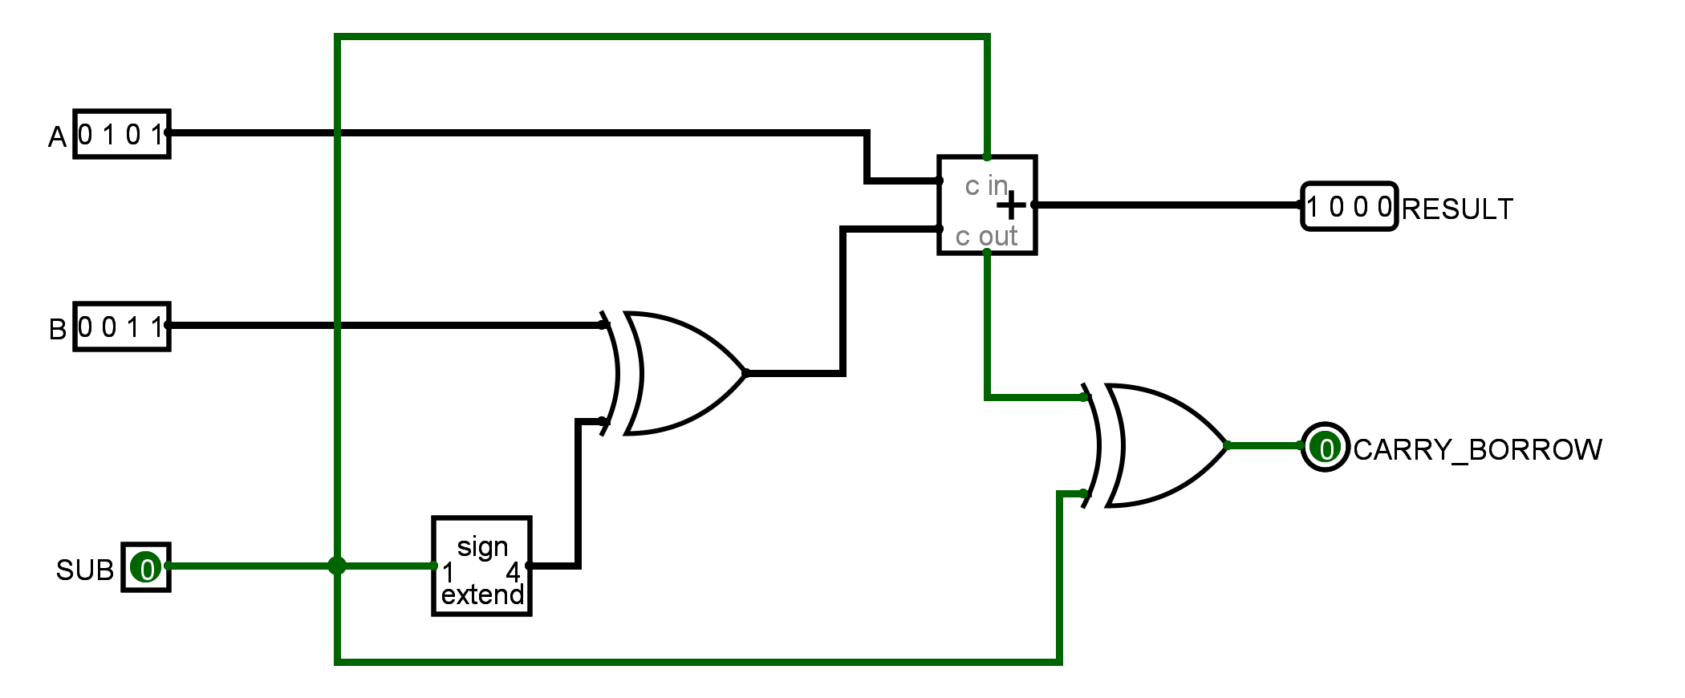
Results: Circuit Simulation
Logisim circuit: 0101 + 0011 = 1000
Observed: RESULT = 1000 and carry = 0, matching the expected sum of 5 + 3.
Notes:
Project: 4-bit arithmetic calculator. Source: supplied presentation and verified Logisim circuit. Addition returns (A+B) modulo 16 with carry for A+B>15. Subtraction returns (A-B) modulo 16 with borrow for A<B. All 512 combinations were tested using the Logisim 2.7.1 simulation engine. Tables on slide 11 include the exhaustive 1-bit full-adder table and selected 4-bit cases.

Slide 11
Results: Truth Tables & Discussion
Full-adder truth table
Operation control
Aᵢ | B′ᵢ | Cᵢ | Rᵢ | Cᵢ₊₁
0 | 0 | 0 | 0 | 0
0 | 0 | 1 | 1 | 0
0 | 1 | 0 | 1 | 0
0 | 1 | 1 | 0 | 1
1 | 0 | 0 | 1 | 0
1 | 0 | 1 | 0 | 1
1 | 1 | 0 | 0 | 1
1 | 1 | 1 | 1 | 1
SUB | B′ | C₀ | Operation
0 | B | 0 | A + B
1 | NOT B | 1 | A − B
4-bit examples (selected cases)
SUB | A | B | RESULT | Flag
0 | 0101 | 0011 | 1000 | 0
0 | 1111 | 0001 | 0000 | 1
1 | 1001 | 0011 | 0110 | 0
1 | 0011 | 0101 | 1110 | 1
B′ = B XOR SUB. Four stages process bits 0 to 3, with C₀ = SUB.
Flag = carry for addition, borrow for subtraction. RESULT contains the lower 4 bits.
Notes:
Project: 4-bit arithmetic calculator. Source: supplied presentation and verified Logisim circuit. Addition returns (A+B) modulo 16 with carry for A+B>15. Subtraction returns (A-B) modulo 16 with borrow for A<B. All 512 combinations were tested using the Logisim 2.7.1 simulation engine. Tables on slide 11 include the exhaustive 1-bit full-adder table and selected 4-bit cases.

Slide 12
Conclusion
Project achievements
The completed Logisim circuit performs 4-bit addition and subtraction through one adder.
A single SUB input controls conditional inversion, carry-in, and interpretation of the flag.
Objectives fulfilled
The design demonstrates two’s complement and displays both result and carry/borrow.
All 512 input combinations passed result and flag checks in the Logisim simulation engine.
Limitations and future work
This is a simulated combinational design with 4-bit unsigned inputs and modulo-16 results.
Future work could add signed-overflow detection, wider operands, or physical implementation.
Notes:
Project: 4-bit arithmetic calculator. Source: supplied presentation and verified Logisim circuit. Addition returns (A+B) modulo 16 with carry for A+B>15. Subtraction returns (A-B) modulo 16 with borrow for A<B. All 512 combinations were tested using the Logisim 2.7.1 simulation engine. Tables on slide 11 include the exhaustive 1-bit full-adder table and selected 4-bit cases.

